Slide 1
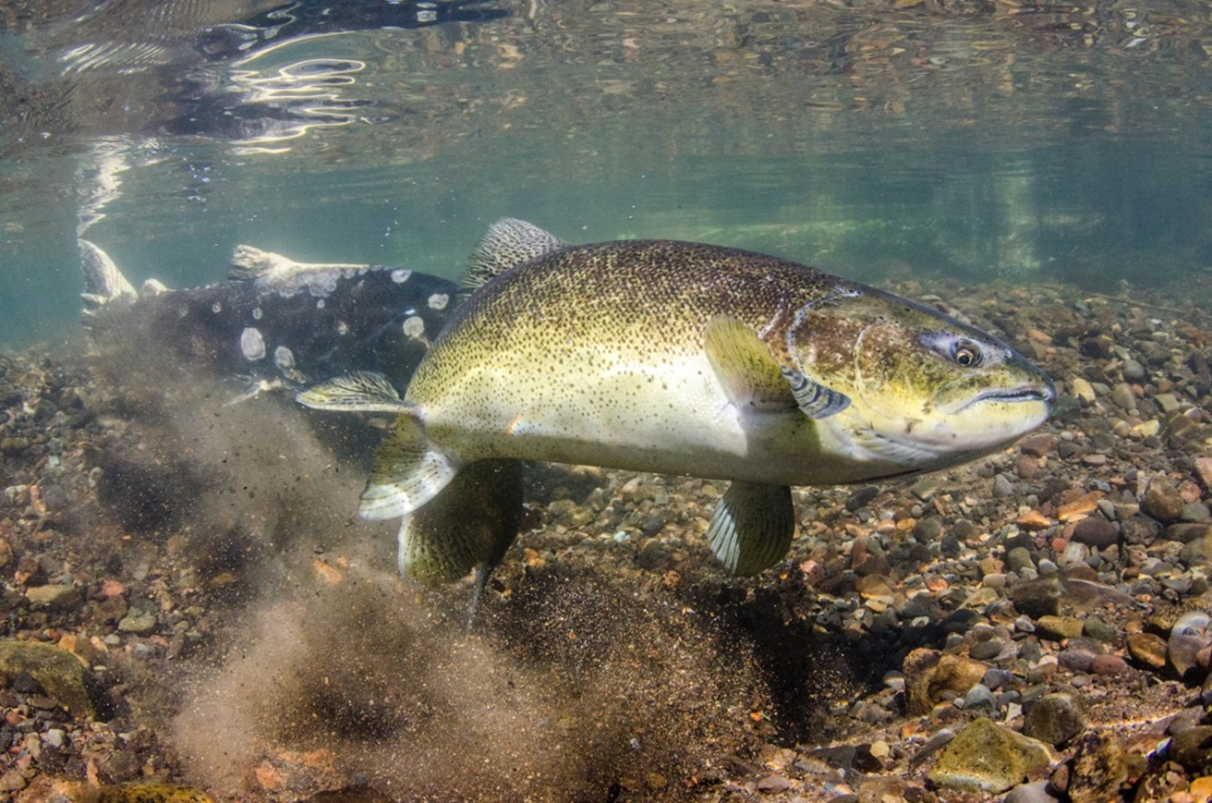
Towards a life-cycle model to inform conservation-hatchery management
Photo: Morgan Bond
Mark H. Sorel
FISH 558
Autumn 2019

Slide 2
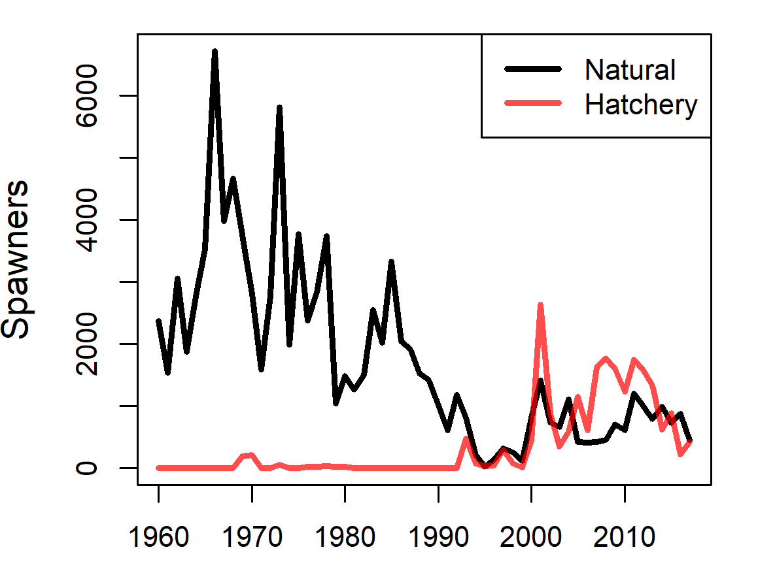
Wenatchee River spring Chinook
Notes:
The population of spring run Chinook salmon in the Wenatchee declined precipitously from the 1970’s through the 1990’s, as did many others in the region, at which time a conservation hatchery program was developed

Slide 3
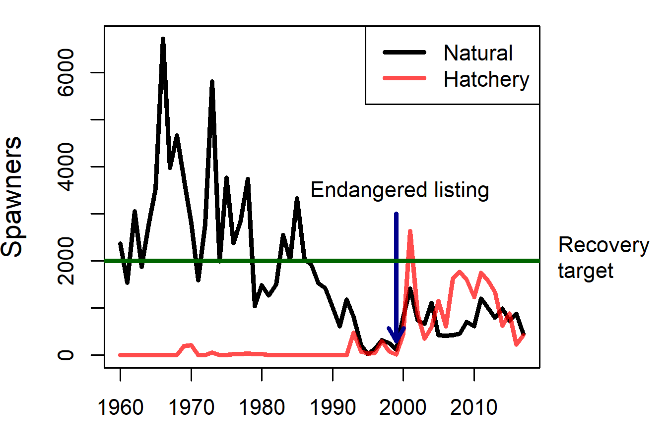
Wenatchee River spring Chinook
Notes:
The population of spring run Chinook salmon in the Wenatchee declined precipitously from the 1970’s through the 1990’s, as did many others in the region, at which time a conservation hatchery program was developed

Slide 4
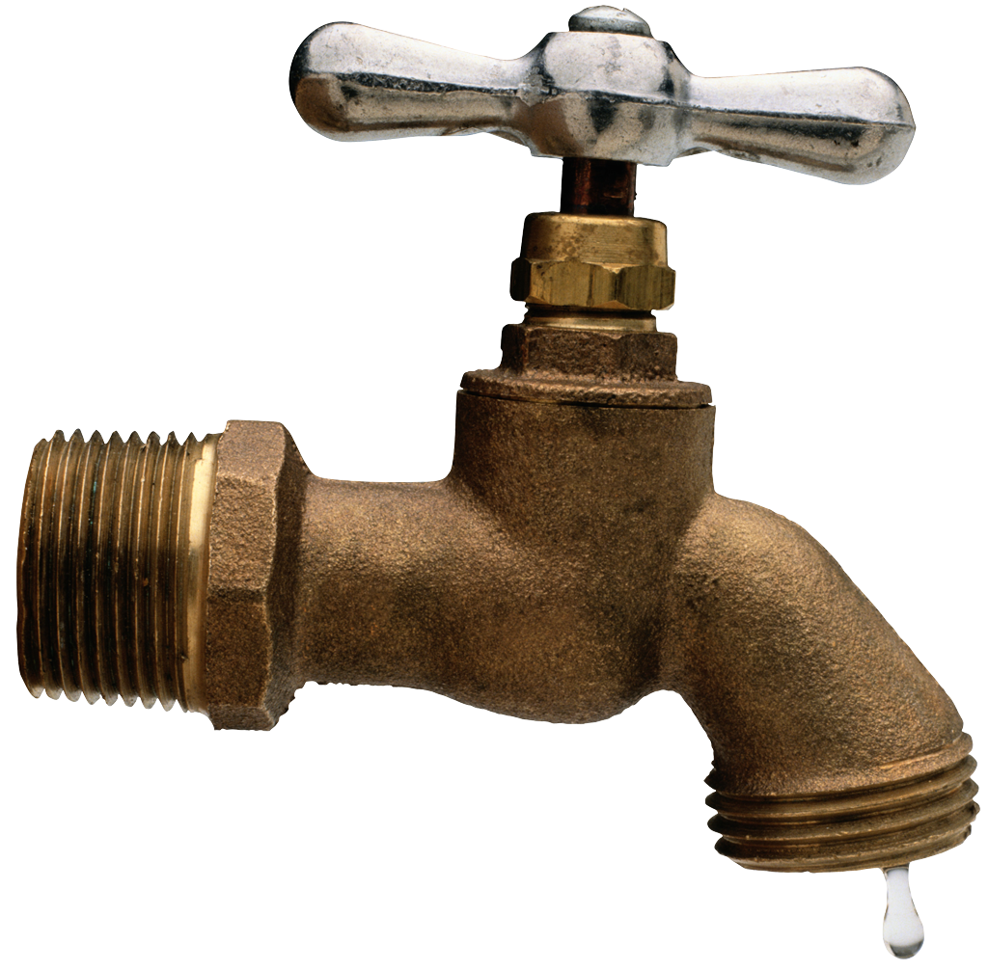
pNI targets, pHOS,
HOR ceiling, NOR cutoff
Broodstock
Broodstock
Conservation
Natural
origin
Conservation
Safety-net
J. Jorgensen

Slide 5
Current control rule
pHOS = proportion hatchery-origin spawners
pNOB = proportion natural-origin Broodstock

Slide 6
Decision table
Management
Natural-origin spawners taken for broodstock
Hatchery-origin spawners allowed on spawning ground
States of nature
Habitat
Climate
Performance
Quasi-extinction probability
Average natural-origin spawners
Average proportion of hatchery origin spawners (pHOS)
Average proportionate natural influence (PNI)

Slide 7
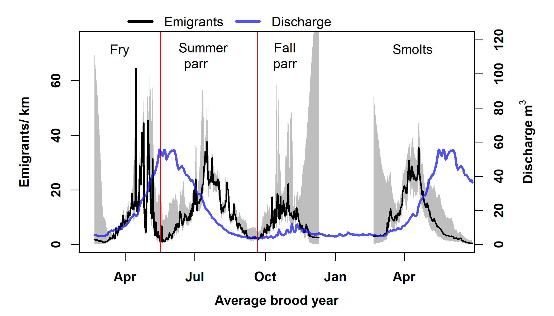
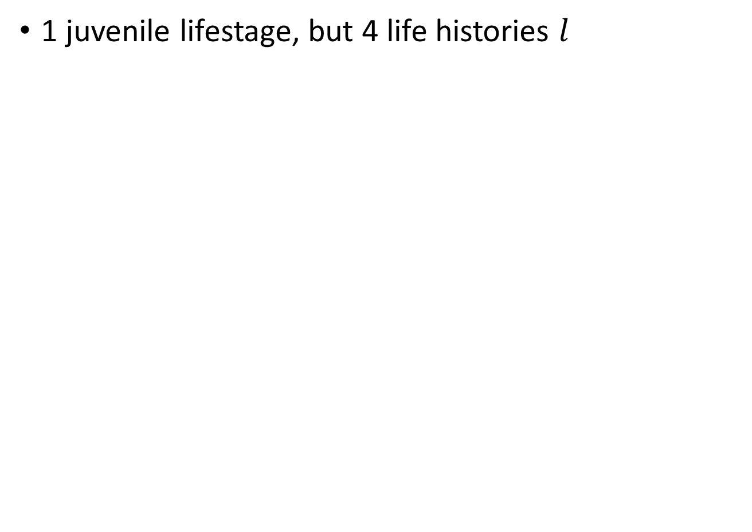
Life cycle model
1 juvenile lifestage, but 4 life histories $l$
Spawners
Fry
Summer parr
Fall parr
Smolts

Slide 8
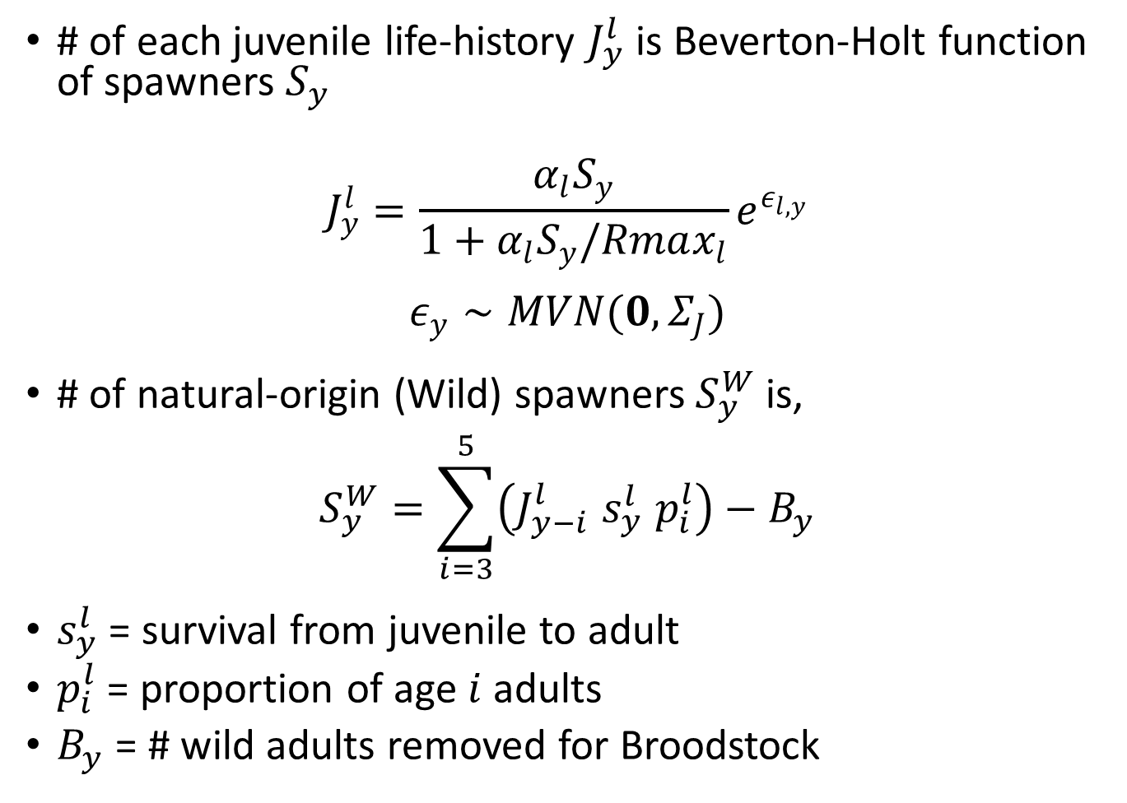
Life cycle model
# of each juvenile life-history $J_{y}^{l}$is Beverton-Holt function of spawners $S_{y}$
$$J_{y}^{l}=\frac{α_{l}S_{y}}{1+α_{l}S_{y}/Rmax_{l}}e^{ε_{l,y}}$$
$$ε_{y}∼MVN(0,Σ_{J})$$
# of natural-origin (Wild) spawners $S_{y}^{W}$is,
$$S_{y}^{W}=\sum_{i=3}^{5}{\left(J_{y−i}^{l} s_{y}^{l} p_{i}^{l}\right)}−B_{y}$$
$s_{y}^{l}$ = survival from juvenile to adult
$p_{i}^{l}$ = proportion of age $i$adults
$B_{y}$ = # wild adults removed for Broodstock

Slide 9
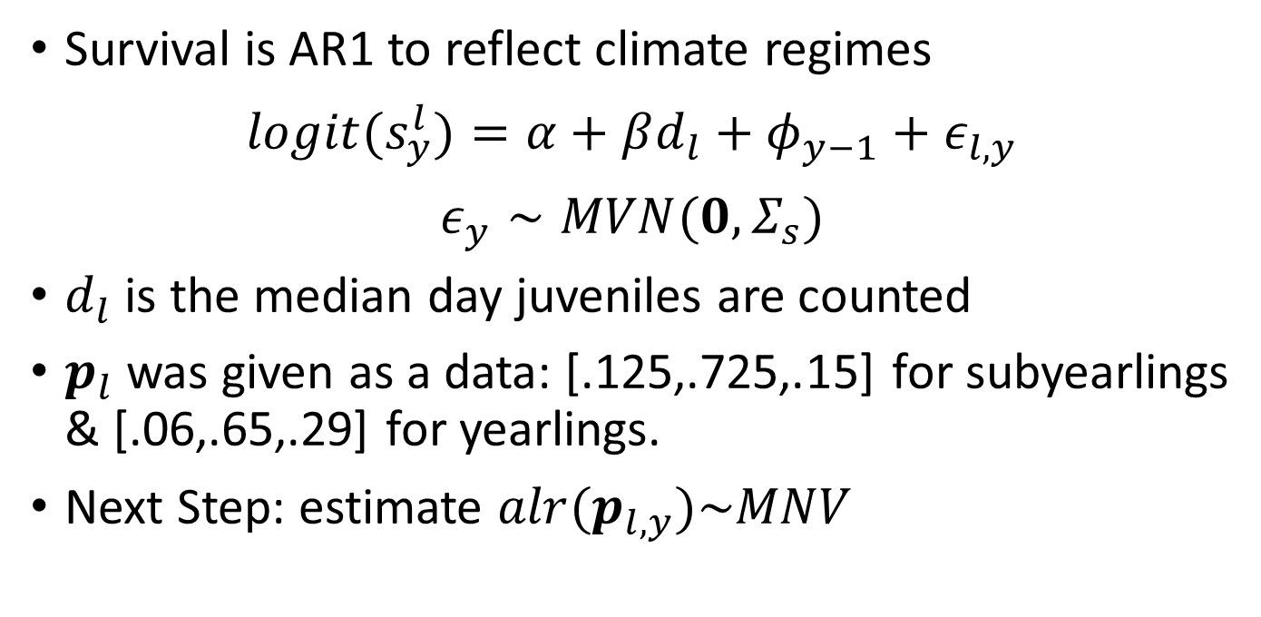
Life cycle model cont.
Survival is AR1 to reflect climate regimes
$$logit(s_{y}^{l})=α+βd_{l}+φ_{y−1}+ε_{l,y}$$
$$ε_{y}∼MVN(0,Σ_{s})$$
$d_{l}$ is the median day juveniles are counted
$p_{l}$ was given as a data: [.125,.725,.15] for subyearlings & [.06,.65,.29] for yearlings.
Next Step: estimate ${alr(p}_{l,y})\sim MNV$

Slide 10
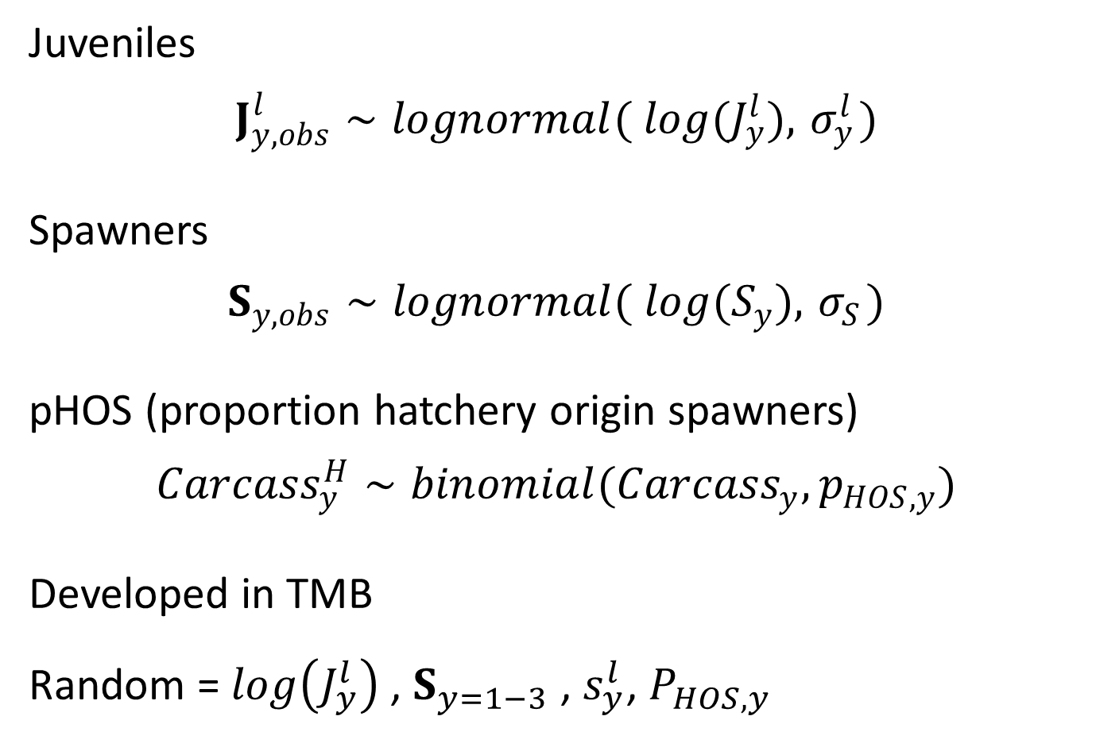
Life cycle model cont.: Data models
Juveniles
$$J_{y,obs}^{l}∼lognormal( log(J_{y}^{l}), { σ}_{y}^{l})$$
Spawners
$$S_{y,obs}∼lognormal( log(S_{y}),{ σ}_{S})$$
pHOS (proportion hatchery origin spawners)
$${Carcass}_{y}^{H}∼binomial({Carcass}_{y},p_{HOS,y})$$
Developed in TMB
Random = $log\left(J_{y}^{l}\right)$, $S_{y=1−3}$ , $s_{y}^{l}$, $P_{HOS,y}$

Slide 11
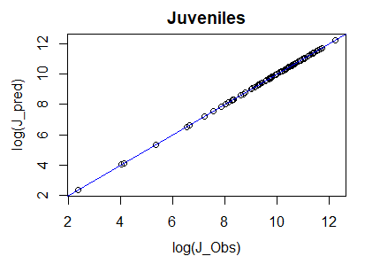
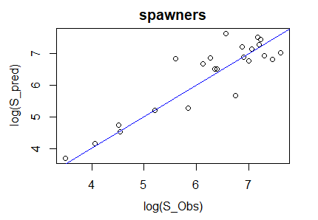
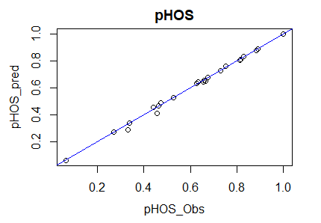
Model fit
Spawner CV too high

Slide 12
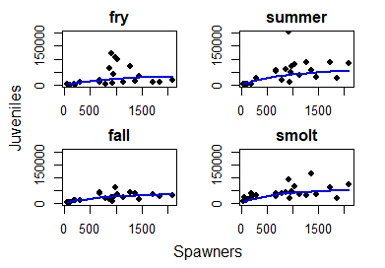
Beverton-holt spawner → juvenile fits

Slide 13
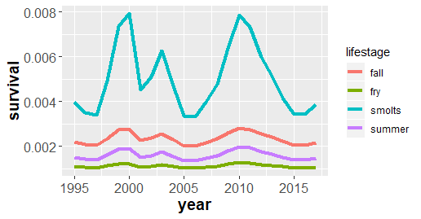
Juvenile → adult survival

Slide 14
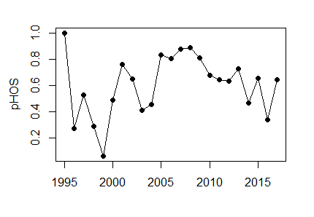
Retrospective performance metrics
Quasi-extinctions = 1?
Mean natural-origin spawners = 273.6
Mean pHOS = 0.6
Mean pNI = 0.45

Slide 15
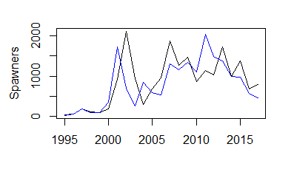

Slide 16
Next steps
Estimate age composition by year
ALR(p)~MVN
Bring in mark-recapture survival data
Do projections and make decision table

Slide 17
Acknowldgements
Buhle et al. 2018

Slide 18
Questions

Slide 19
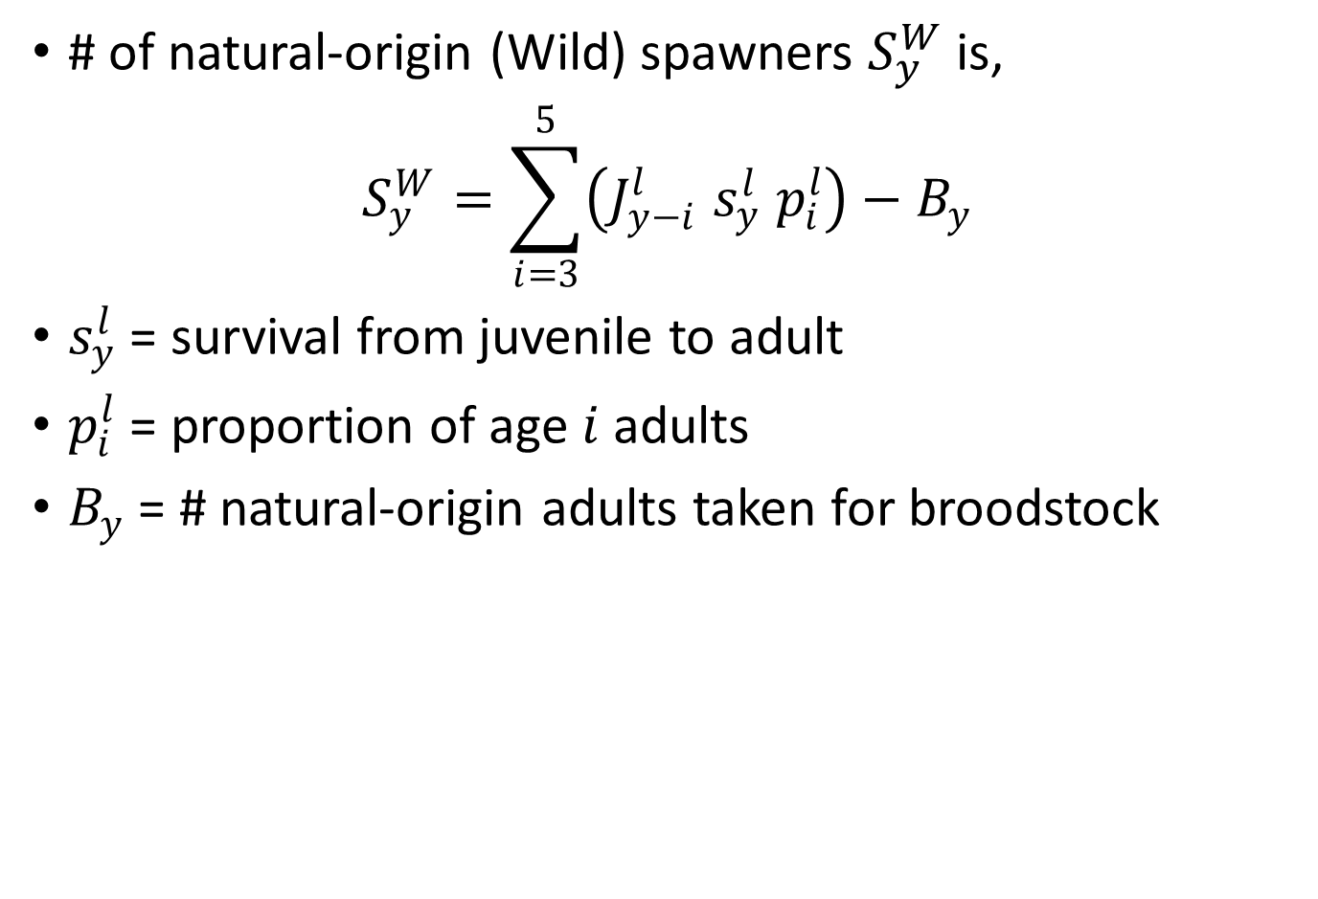
Life cycle model cont.
# of natural-origin (Wild) spawners $S_{y}^{W}$is,
$$S_{y}^{W}=\sum_{i=3}^{5}{\left(J_{y−i}^{l} s_{y}^{l} p_{i}^{l}\right)}−B_{y}$$
$s_{y}^{l}$ = survival from juvenile to adult
$p_{i}^{l}$ = proportion of age $i$adults
$B_{y}$ = # natural-origin adults taken for broodstock

Slide 20
Wenatchee River spring Chinook
Spawning
Migrant traps
Notes:
The Wenatchee river is a tributary of the Upper Columbia river, which drains a stretch of the eastern slope of the Cascade Mountains in the center of Washington state. . The spring run of Chinook there return to the Columbia River relatively early to facilitate migration to the upper reaches of watershed where they spawn primarily in tributaries: chiefly the Chiwawa River, Nason Creek, and the White River.

Slide 21
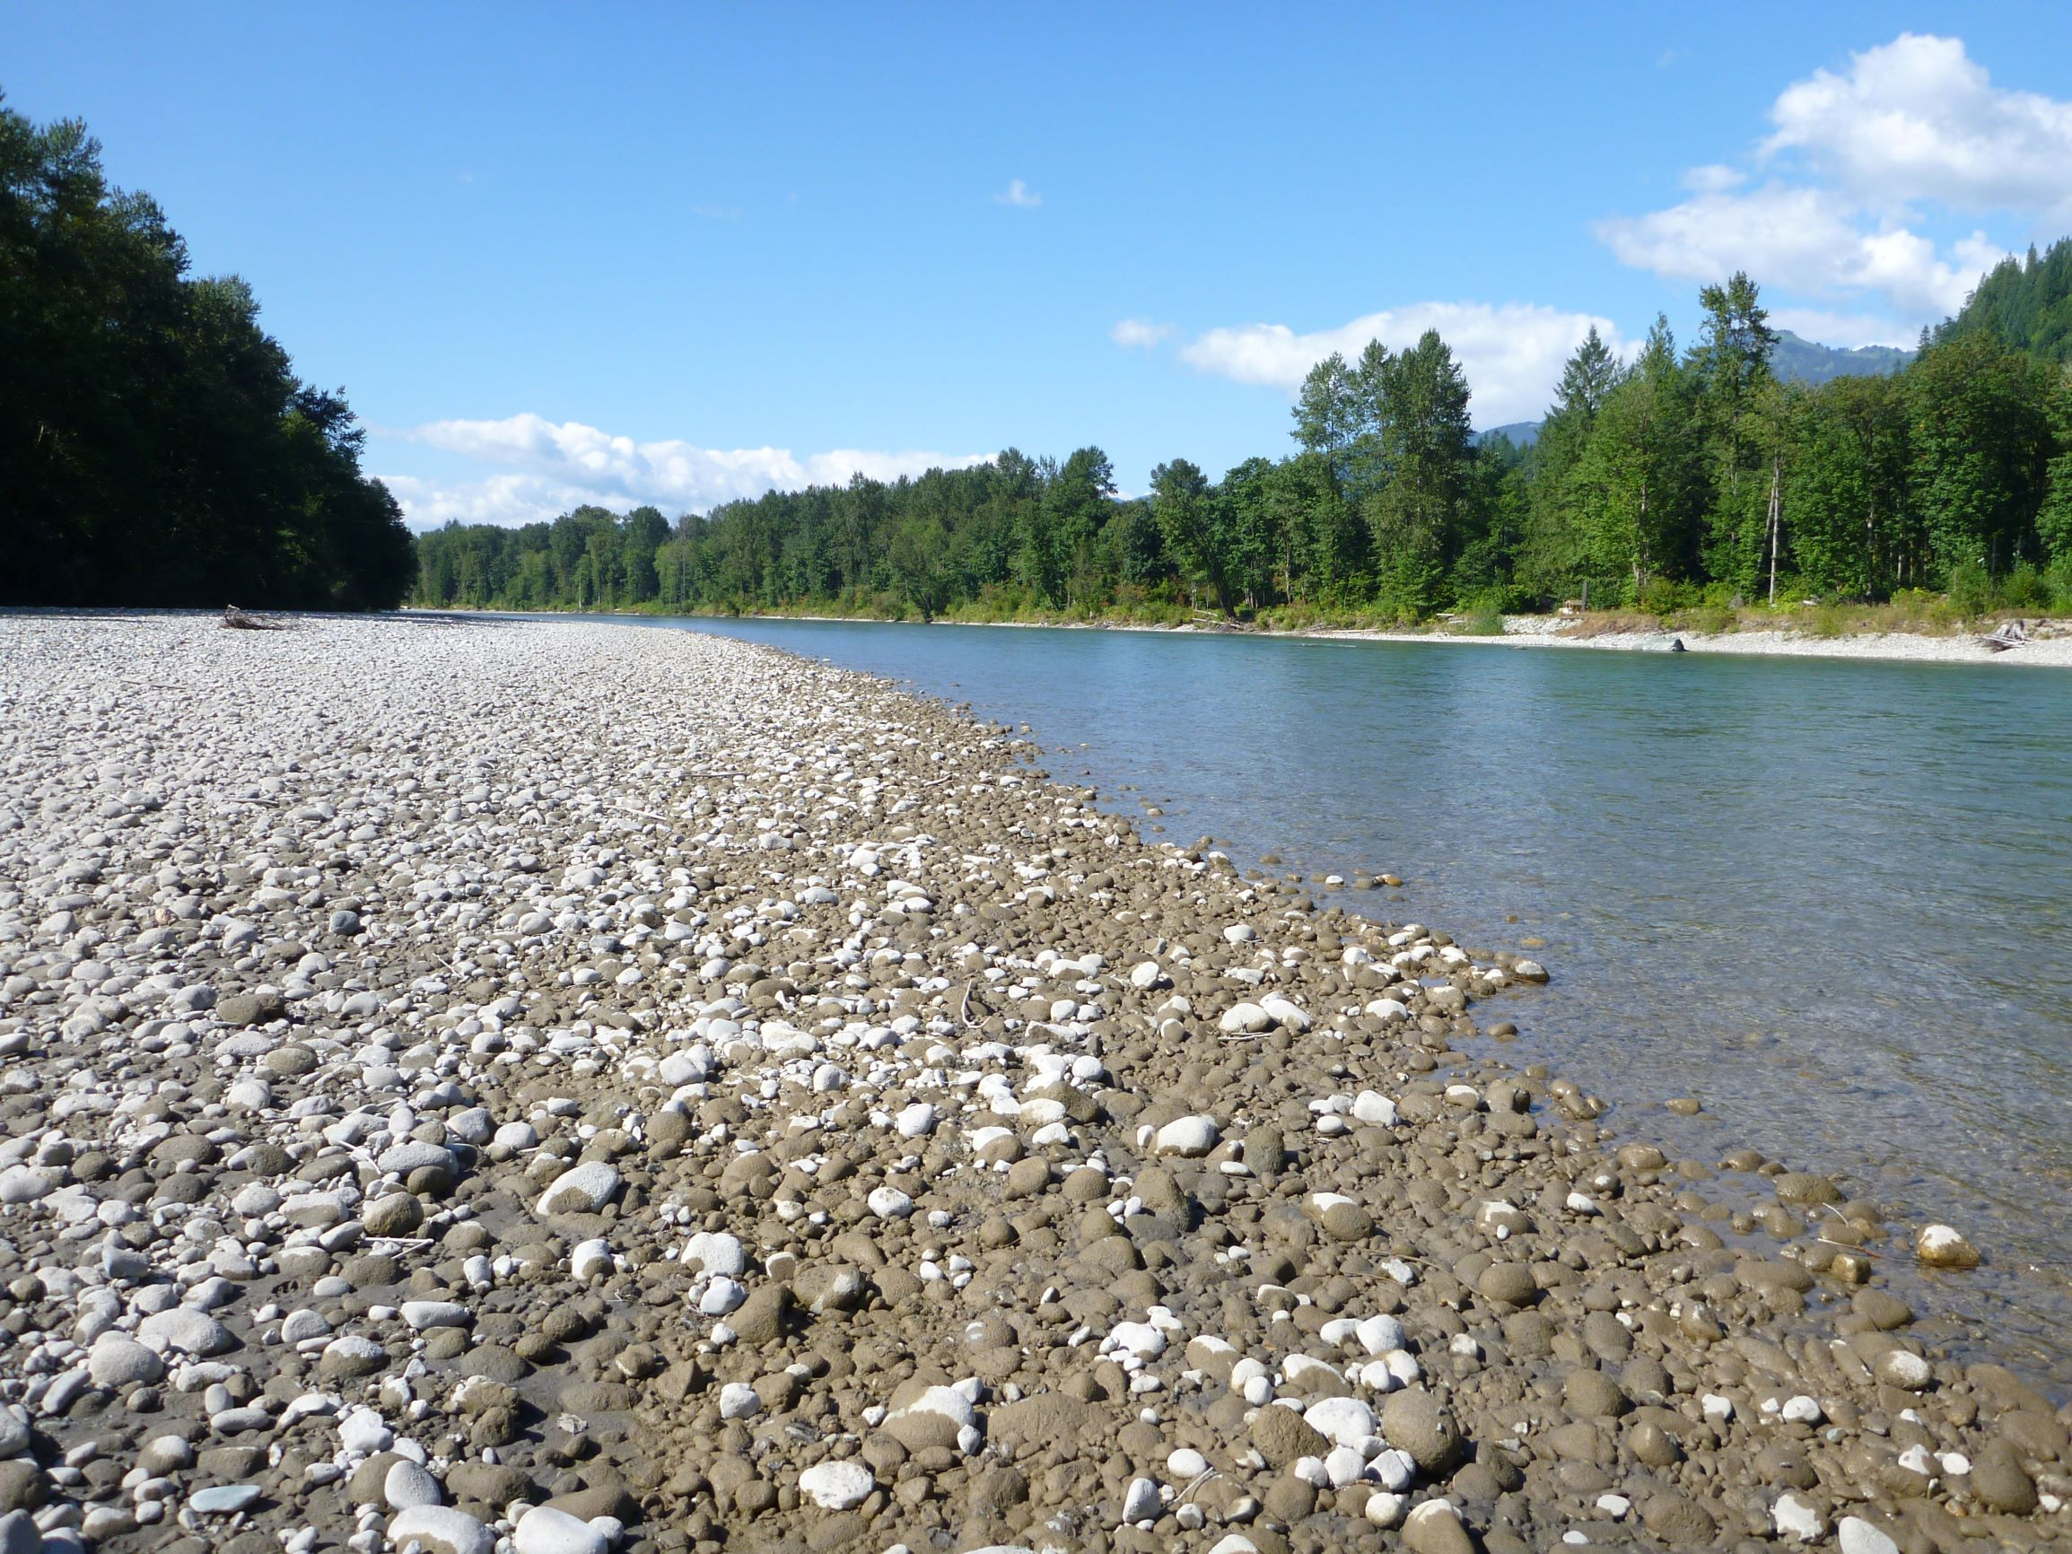
Methods: Juvenile abundance
Data
Daily catch
Mark-recapture efficiency trials
Model
Daily time scale
# of emigrants a times series (AR1)
Capture efficiency a function of discharge, lifestage, and position
Observed with negative binomial error
Summed to get total emigrants

Slide 22
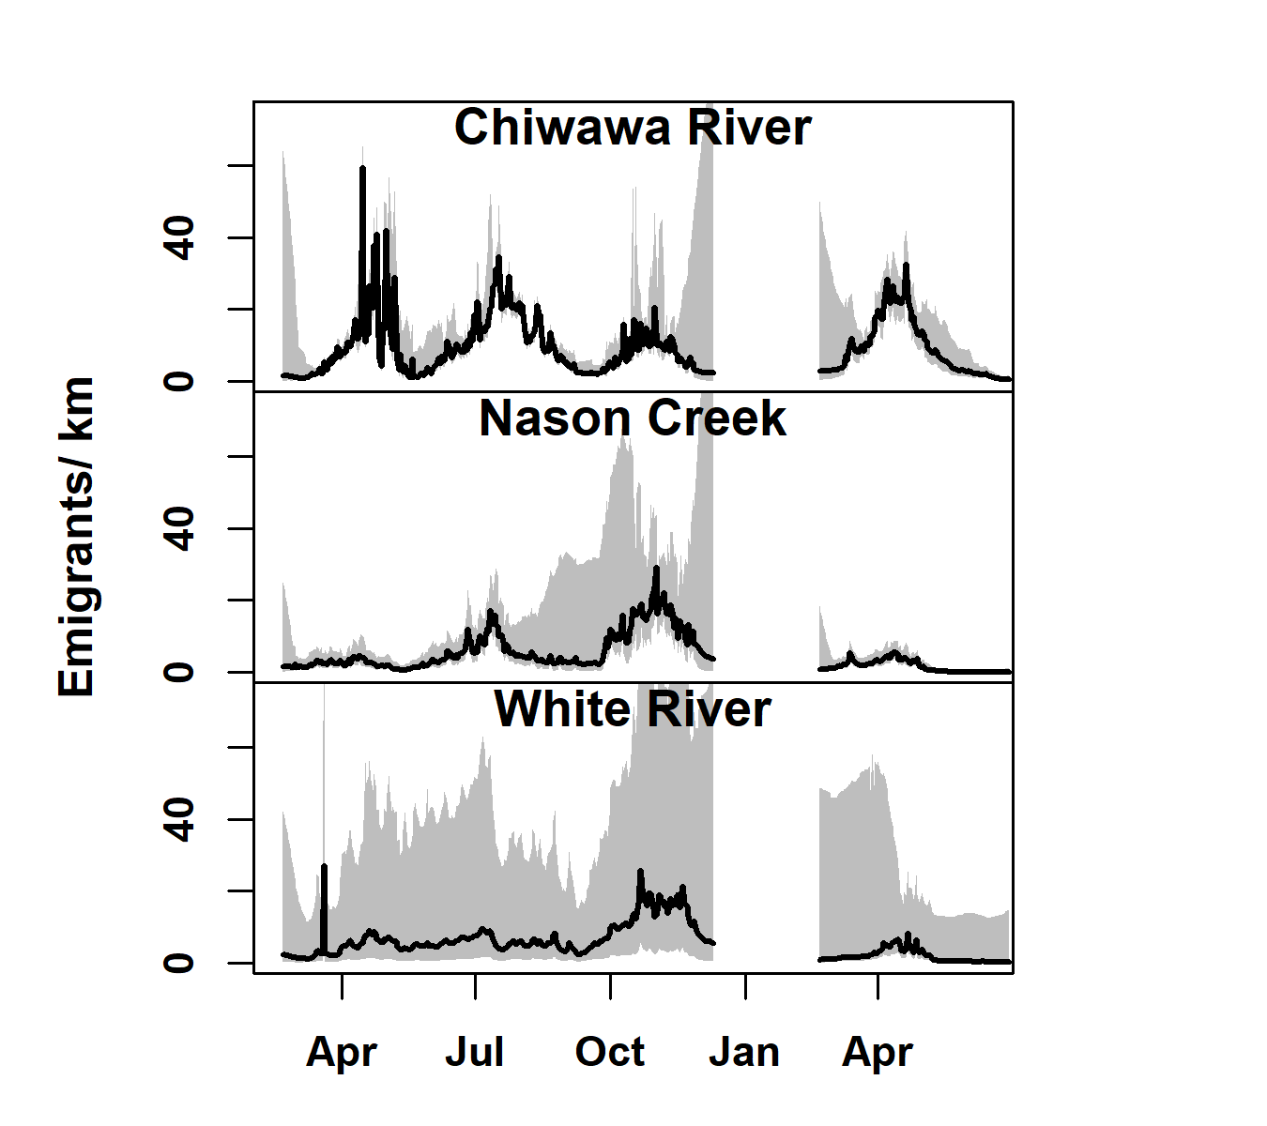
Average daily emigrants

Slide 23
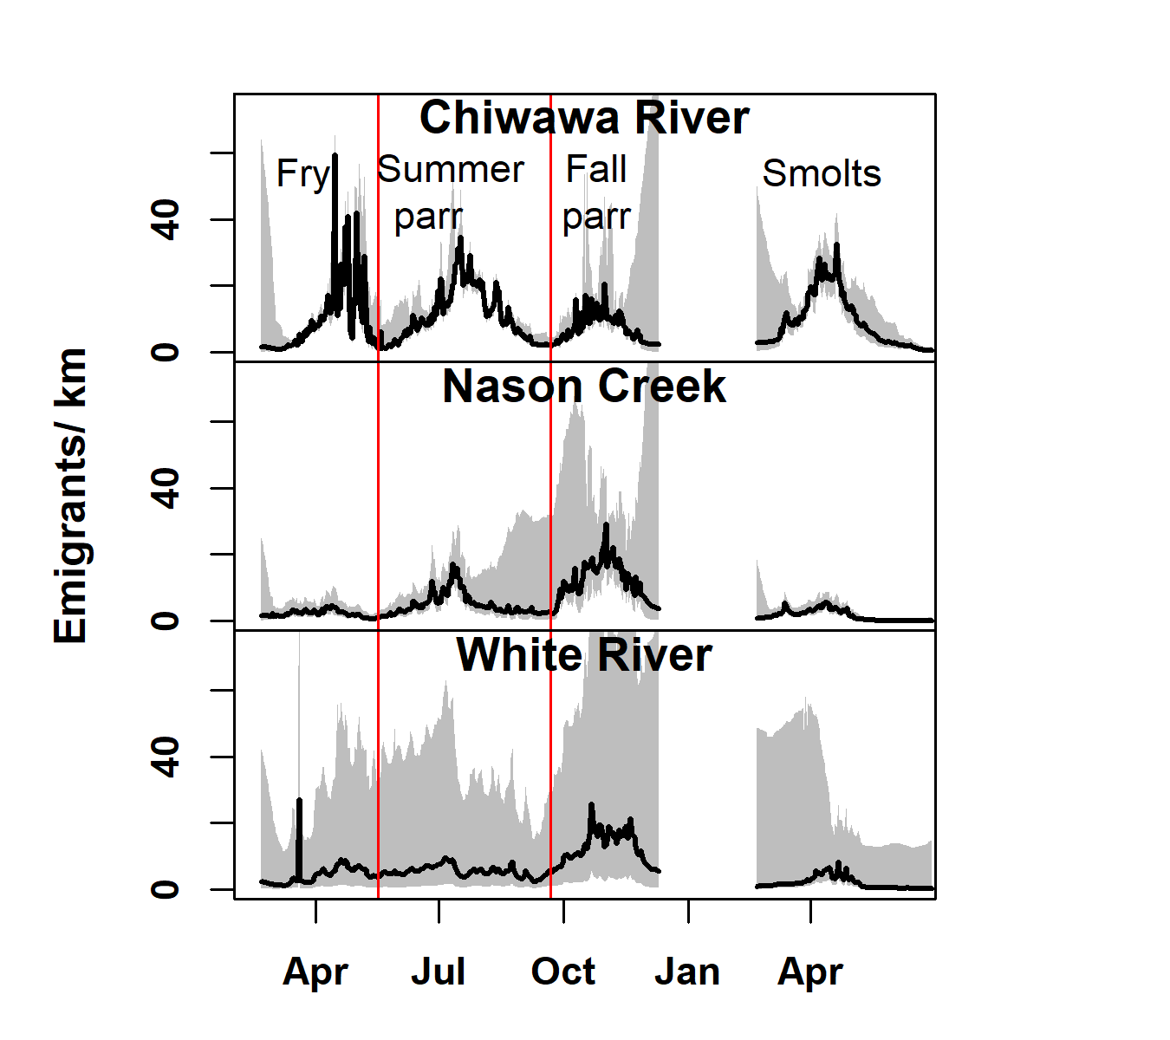
Average daily emigrants
4 life histories
Delineated based on modes in time series
Summed across days to get total per year

Slide 24
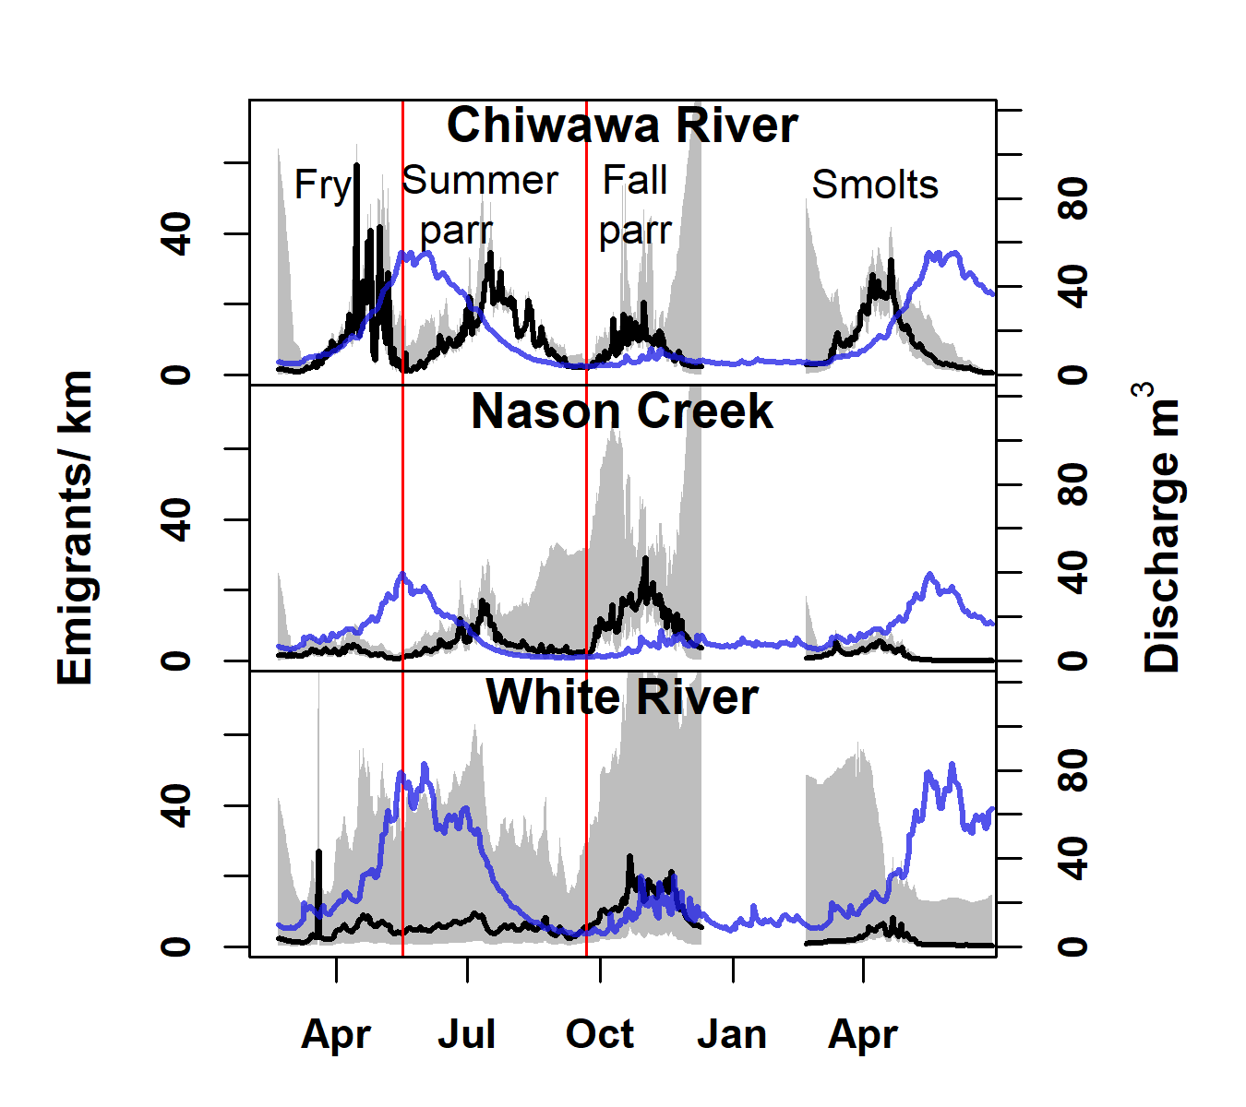
Average daily emigrants
4 life histories
Delineated based on modes in time series
Summed across days to get total per year

Slide 25
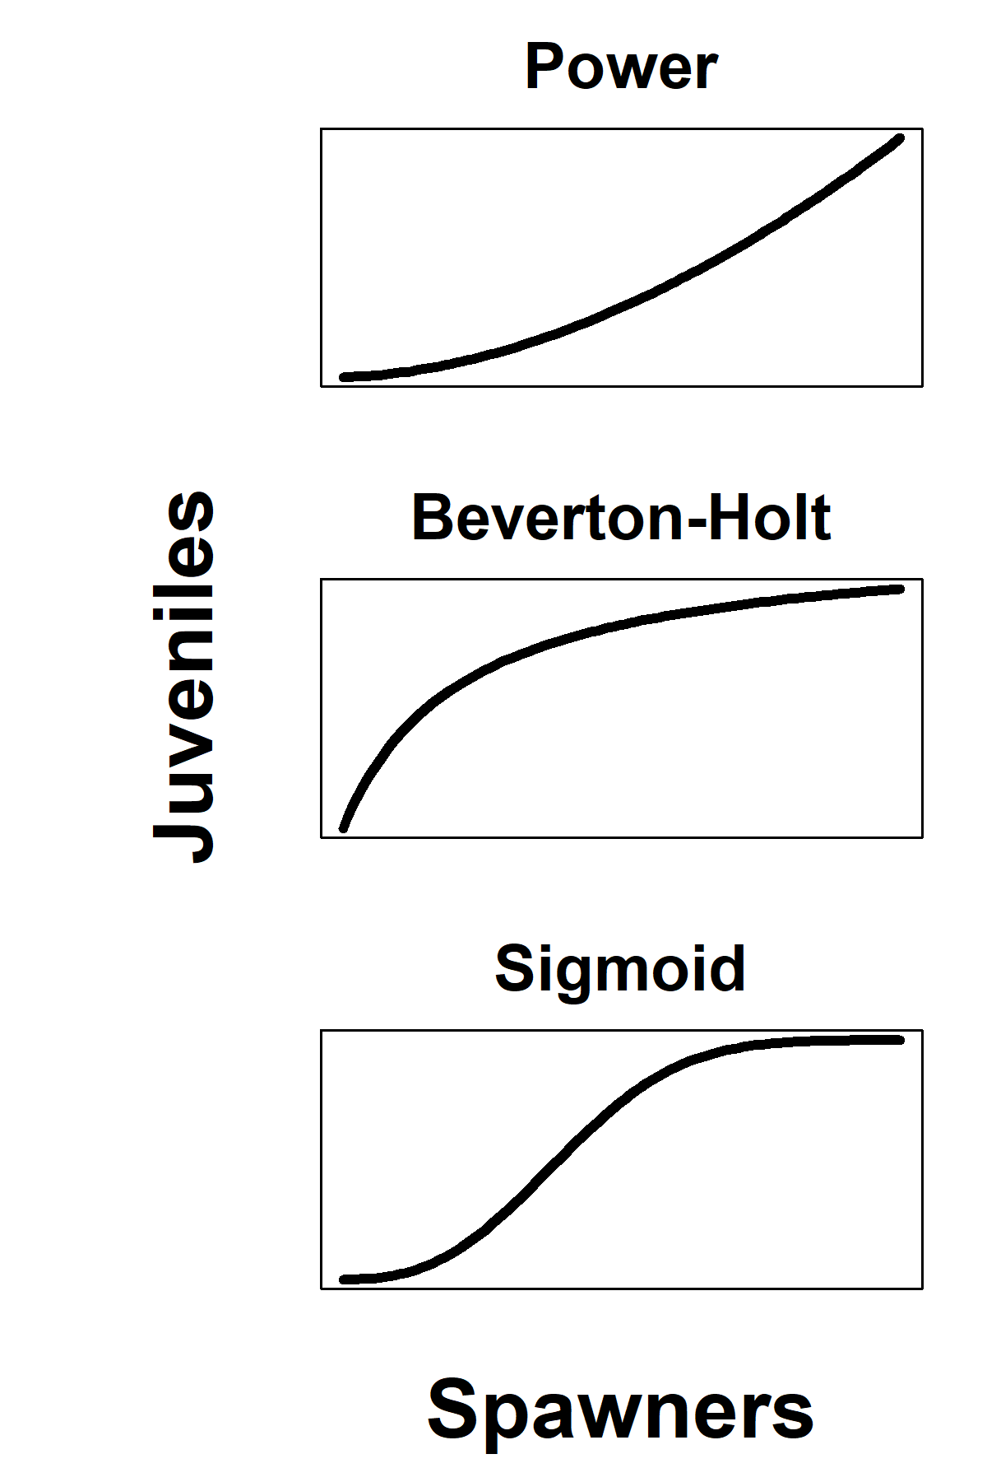
Methods: Spawner-juvenile models
Positive density-dependence
Negative density-dependence
Positive and negative density-dependence
Notes:
For the transitions, I tested three different functional forms for each life history. The power function could arise from positive density-dependent migration, where juveniles fill up the habitat in their natal stream and respond by emigrating at accelerating rates. The beverton-holt represents negative density-dependence that could arise from exceeding some carrying capacity, leading to density dependent emigration or survival prior to when a particular juvenile life history emigrates from the natal stream. Finally, the sigmoid relationship would arise if there was both positive and negative density dependence acting on the juveniles prior to emigration.

Slide 26
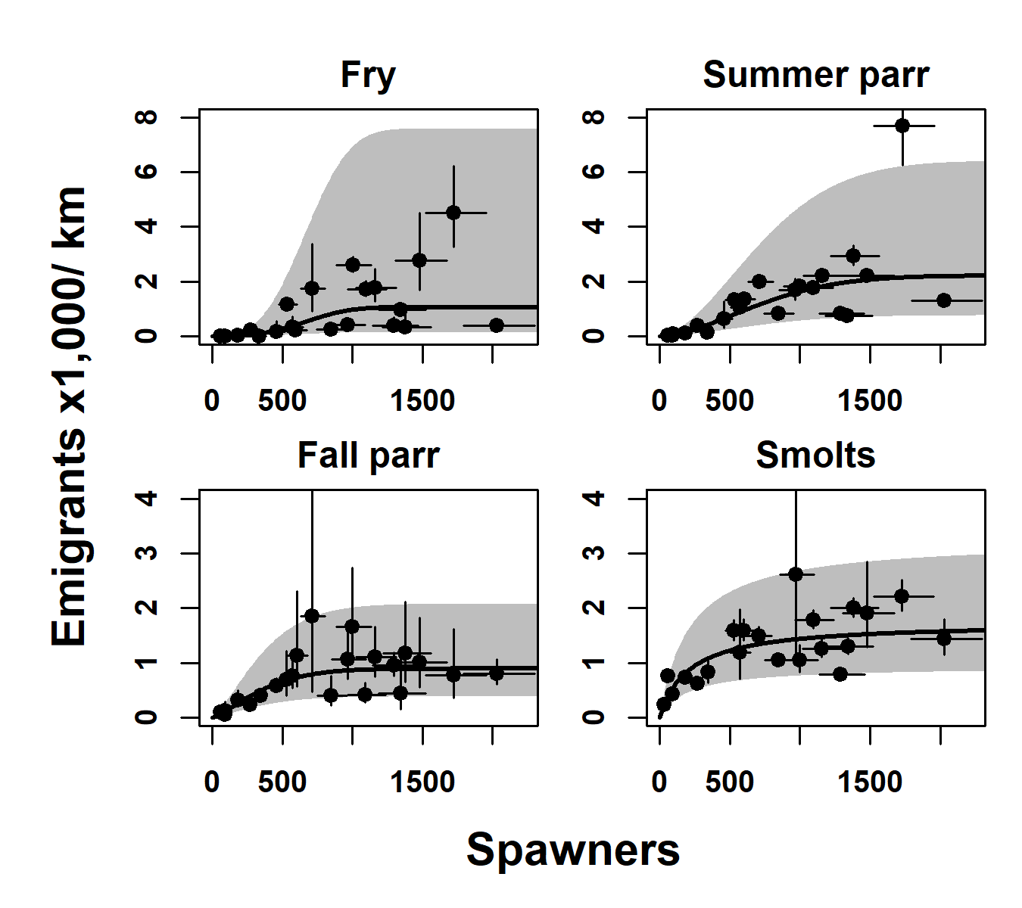
Chiwawa River
+ & - density dependence for fry and summer parr
- density dependence for fall parr and smolts
Similar numbers of all life histories

Slide 27
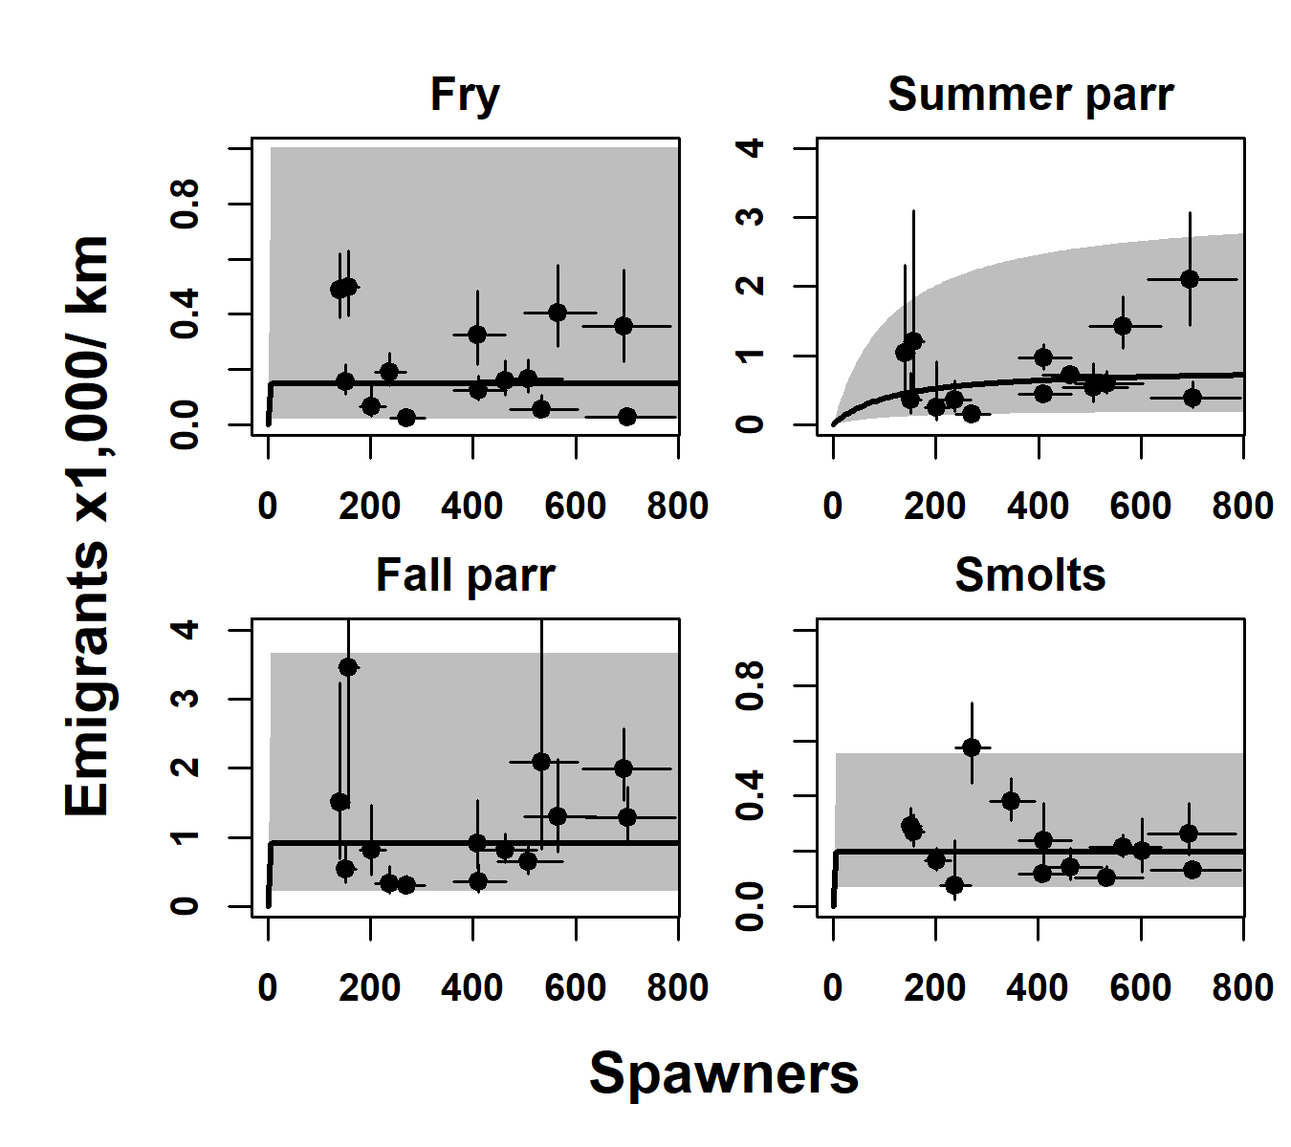
Nason Creek
- density dependence for all life histories
Summer and fall parr most numerous

Slide 28
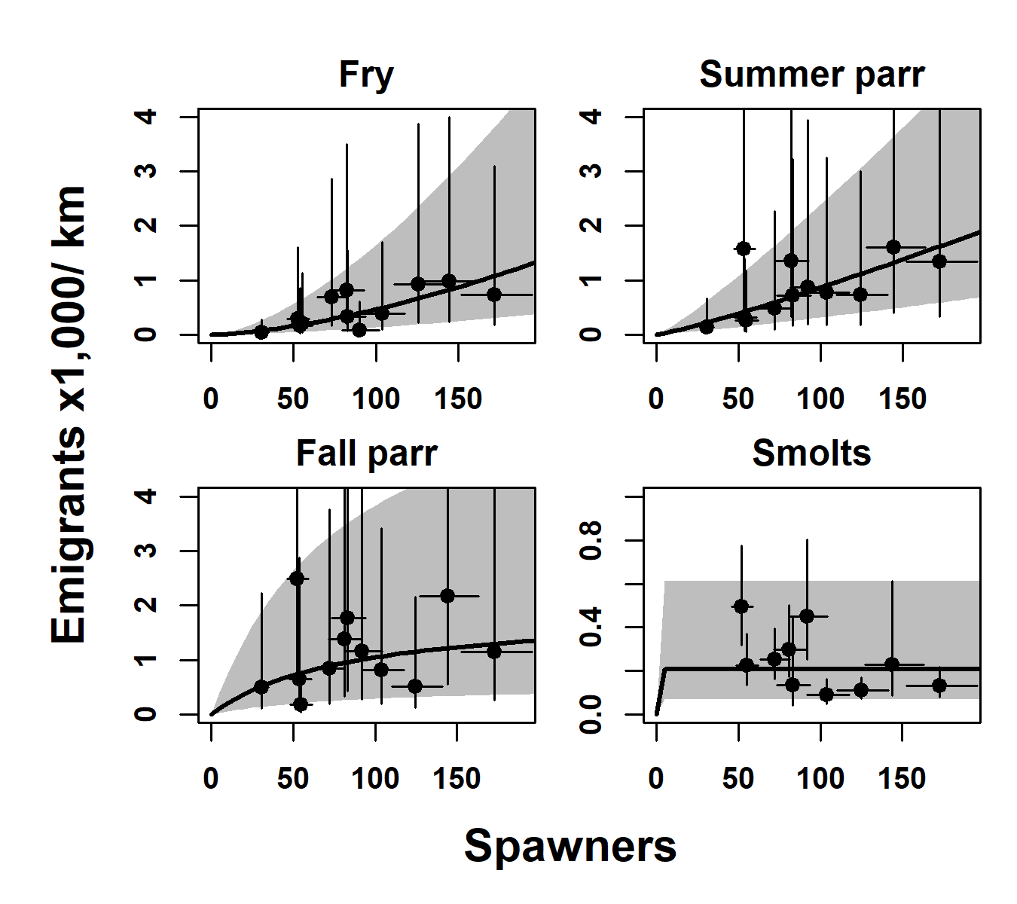
White River
High observation and process error
+ density dependence for fry and summer parr
- density dependence for fall parr and smolts

Slide 29
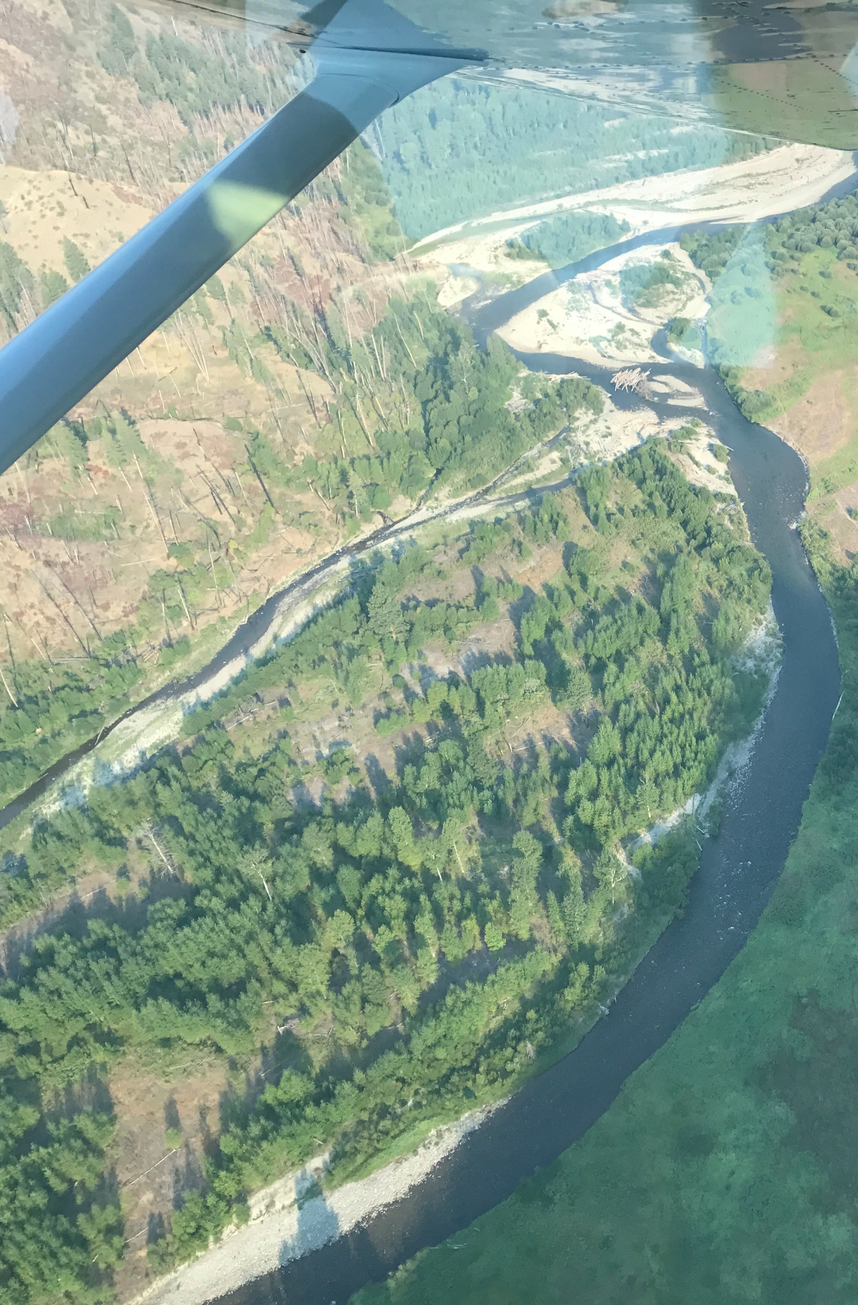
Discussion
Negative density dependence after summer in all streams
Supports summer rearing capacity as density-dependent factor
Different proportions of life histories observed across streams
Suggests habitat differences

Slide 30
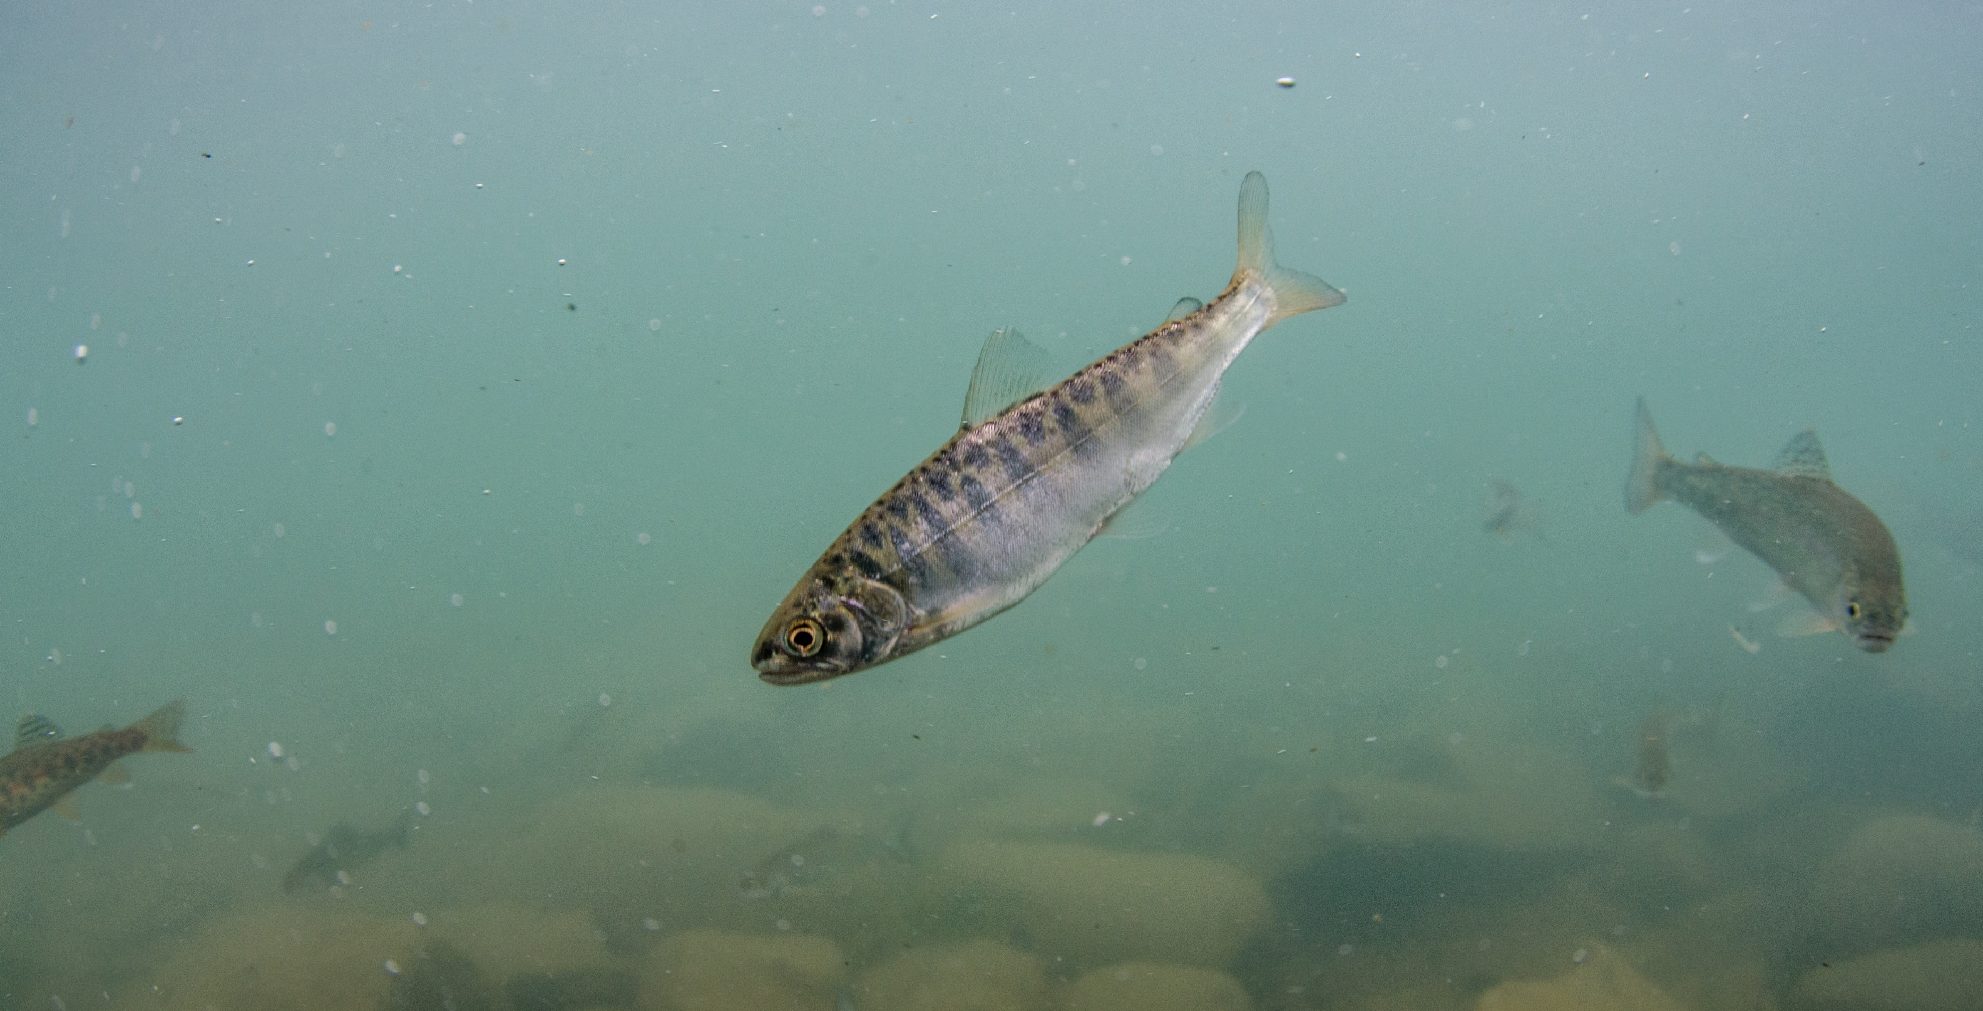
Next Steps
Photo: M. Bond
Explore relationships between fish and habitat data
Integrate with survival data to create population model
Use to evaluate management alternatives

Slide 31
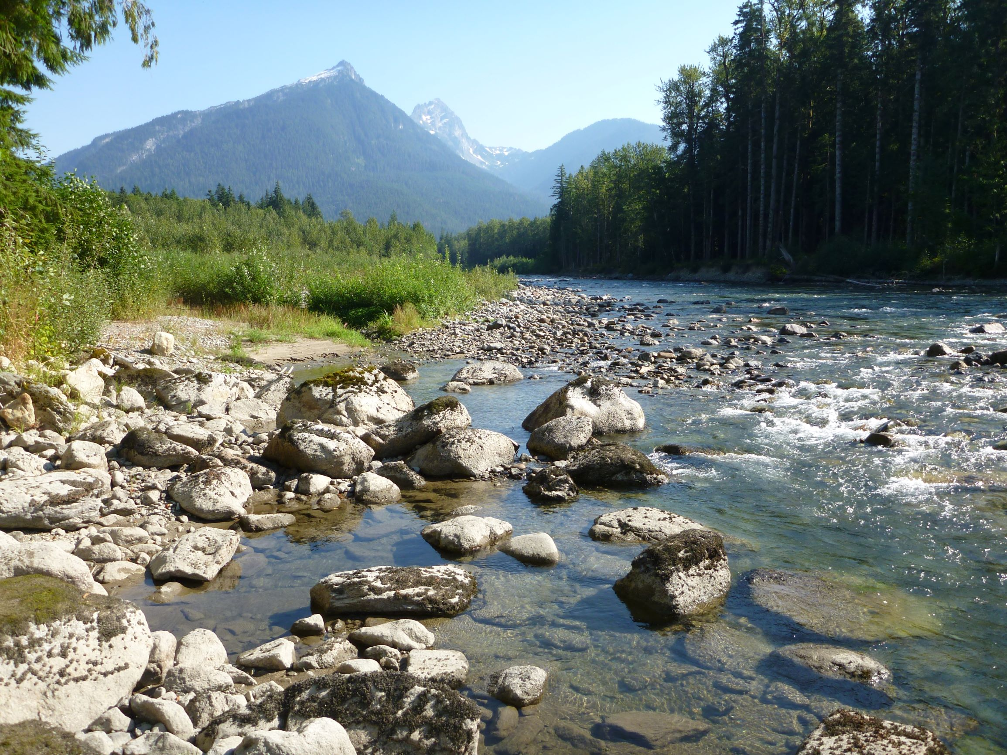
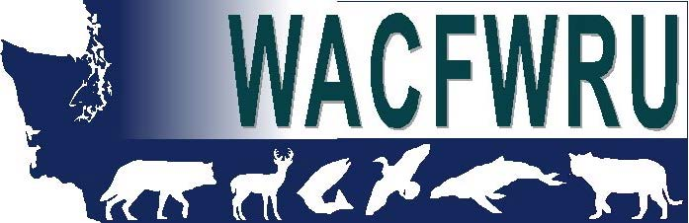





Acknowledgements
Data
Washington Department of Fish and Wildlife
Yakama Nation
Grant and Chelan County Public Utilities Districts
U.S. Geologic Survey
Funding
Northwest Fisheries Science Center, National Oceanic and Atmospheric Administration
Washington Cooperative Fish and Wildlife Research Unit, U.S. Geologic Survey, and University of Washington

